Slide 1
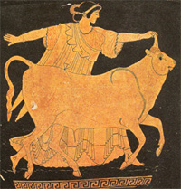
Greek Educational system
School of European Education
Heraklion Greece

Slide 2
The Greek Educational system divided into three levels
Primary level
Secondary level
Tertiary level

Slide 3
Compulsory Education
Compulsory education is for all children between the age group of 6-15 years. The compulsory education includes Primary Education also known as Dimotiko and Lower Secondary Education also known as Gymnasio.

Slide 4
Pre-Primary Level of Education
Children of 4 years attend private or public schools (pre-primary). It is not compulsory . The pre-primary level of education also includes child care along with education for children of less than 4 years.

Slide 5
Primary Level of Education
The primary is provided for all children between the age group of 6-12 years. Depending upon the number of regular teachers, the schools proving primary education can be divided into – one teacher school, two teacher schools, etc. up to twelve teachers. Subjects like Mathematics, Greek Language (Modern), Art Education, Information & Communication Technology and Physical Education are taught in all grades of primary level education.

Slide 6
Primary Level of Education
Apart from the regular primary schools, there are some other school types of schools providing primary education. They are:
European School
Special Schools (School Units)
Cross Cultural Education Schools
Minority Schools
Primary schools (All day)
The primary schools (all-day) was mainly introduced to expand teaching hours and also to fulfill the needs of contemporary conditions that are arising from the children’s families.

Slide 7
Secondary Level of Education
The secondary education in Greece is classified into two levels, there is also the provision for evening schools in both these type of secondary level education. Lower secondary (compulsory) education: The lower secondary (compulsory) type of education is for students between 13-15 age-group offered by Gymnasia, the duration is 3 years. Upper secondary (non-compulsory) education: The upper secondary (non-compulsory) type of education is for students above 15 years of age and is provided by two types of schools, Epaggelmatiko and Geniko Lykeio which is also known as the vocational education.

Slide 8
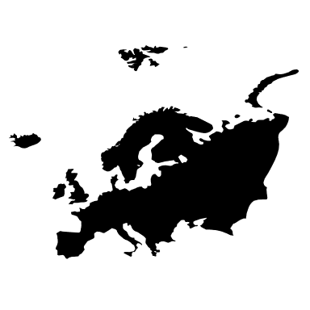
Secondary Level of Education
Apart from the regular secondary schools, there are also other types of secondary education schools providing: Second Chance Schools
Art Schools
Special Education Schools
Experimental Schools
Music Schools
Minority Schools
Cross Cultural Education Schools
Ecclesiastic schools

Slide 9
Post Secondary Level of Education
The post secondary education (non-tertiary) is implemented through Vocational Institutes. After the completion of the course, the graduates receive a Diploma or a Certificate of Vocational Training.

Slide 10
Tertiary Level of Education
The tertiary level of education in Greece comprises of two sectors. The University and the Technological. The University sector includes Universities, Fine Arts School and the Technical Universities while the Technological Education Institutions include Technological (Higher) Education Institutions.

Slide 11
Thank you for your attention

